Slide 1
Cloud Computing
Ing. Daniel Rajčan
Chief Cloud Architect daniel.rajcan@unicorn.com
Ing. Filip Janovič, PhD., MBA
Cloud / DevOps Architect filip.janovic@unicorn.com

Slide 2
Agenda
Definition
Essential Characteristics
Entities
Deployment Models
Statistics

Slide 3
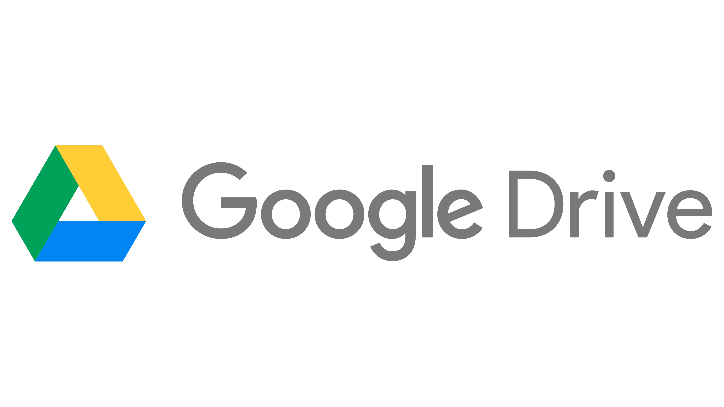
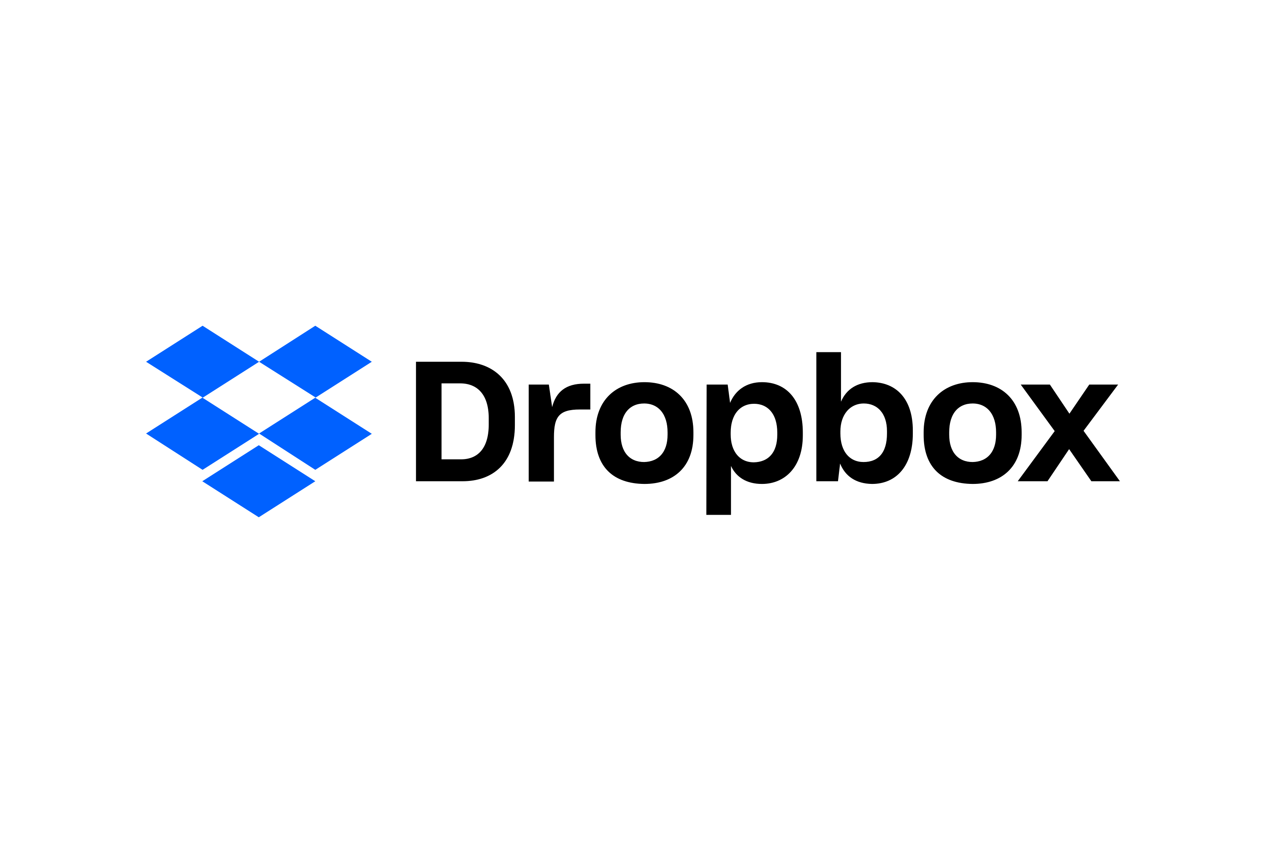

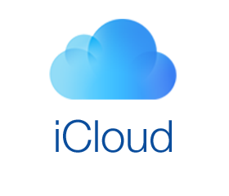
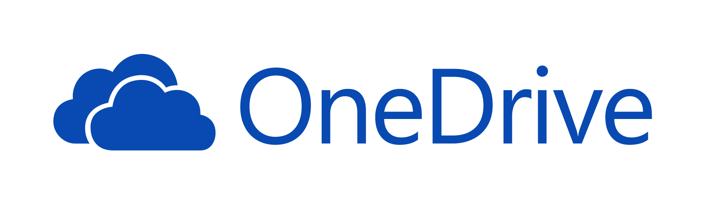
What is Cloud Computing ?

Slide 4


Standardization
Organizations:
Institute of Electrical and Electronics Engineers (IEEE) - an association dedicated to advancing innovation and technological excellence for the benefit of humanity, is the world's largest technical professional society,
National Institute of Standards and Technology (NIST) - founded in 1901, is responsible for establishing technology, standards, and metrics to be applied to the science and technology industries. As one of the oldest science labs in the United States and a part of the U.S.
Documents:
The NIST definition of Cloud Computing
NIST Cloud Computing Reference Architecture
Cloud Computing Synopsis and Recommendations

Slide 5

Definition
Cloud Computing is a model for enabling ubiquitous, convenient, on-demand network access to a shared pool of configurable computing resources (e.g., networks, servers, storage, applications, and services) that can be rapidly provisioned and released with minimal management effort or service provider interaction. This cloud model is composed of five essential characteristics, three service models, and four deployment models.

Slide 6
Definition
Essential Characteristics:
On-demand self-service,
Broad network access,
Resource pooling,
Rapid elasticity,
Measured service.
Entities:
Cloud Consumer,
Cloud Provider,
Cloud Auditor,
Cloud Broker,
Cloud Carrier.
Deployment Models:
Private Cloud,
Community Cloud,
Public Cloud,
Hybrid Cloud.
Service Models:
Software as a Service,
Platform as a Service,
Infrastructure as a Service.

Slide 7
Essential Characteristics

Slide 8
Essential Characteristics
On-demand self-service - A consumer can unilaterally provision computing capabilities, such as server time and network storage, as needed automatically without requiring human interaction with each service provider,
Broad network access - Capabilities are available over the network and accessed through standard mechanisms that promote use by heterogeneous thin or thick client platforms (e.g., mobile phones, tablets, laptops, and workstations),
Resource pooling - The provider’s computing resources are pooled to serve multiple consumers using a multi-tenant model, with different physical and virtual resources dynamically assigned and reassigned according to consumer demand.

Slide 9
Essential Characteristics
Rapid elasticity - Capabilities can be elastically provisioned and released, in some cases automatically, to scale rapidly outward and inward commensurate with demand. To the consumer, the capabilities available for provisioning often appear to be unlimited and can be appropriated in any quantity at any time,
Measured service - Cloud systems automatically control and optimize resource use by leveraging a metering capability at some level of abstraction appropriate to the type of service (e.g., storage, processing, bandwidth, and active user accounts). Resource usage can be monitored, controlled, and reported, providing transparency for both the provider and consumer of the utilized service.

Slide 10
Entities

Slide 11
Entities
Cloud Consumer is the principal stakeholder for the cloud computing service. A cloud consumer represents a person or organization that maintains a business relationship with, and uses the service from a cloud provider,
Cloud Provider acquires and manages the computing infrastructure required for providing the services, runs the cloud software that provides the services, and makes arrangement to deliver the cloud services to the Cloud Consumers through network access,
Cloud Auditor is a party that can perform an independent examination of cloud service controls with the intent to express an opinion thereon. A cloud auditor can evaluate the services provided by a cloud provider in terms of security controls, privacy impact, performance, etc.

Slide 12
Entities
Cloud Broker is an entity that manages the use, performance and delivery of cloud services and negotiates relationships between cloud providers and cloud consumers
In general, a cloud broker can provide services in three categories:
Service Intermediation - a cloud broker enhances a given service by improving some specific capability,
Service Aggregation - a cloud broker combines and integrates multiple services into one or more new services,
Service Arbitrage - it is similar to service aggregation except that the services being aggregated are not fixed.

Slide 13
Entities
Cloud Carrier acts as an intermediary that provides connectivity and transport of cloud services between cloud consumers and cloud providers. Cloud carriers provide access to consumers through network, telecommunication and other access devices

Slide 14
Deployment Models

Slide 15
Deployment Models
Private cloud - The cloud infrastructure is provisioned for exclusive use by a single organization comprising multiple consumers (e.g., business units),
Community cloud - The cloud infrastructure is provisioned for exclusive use by a specific community of consumers from organizations that have shared concerns (e.g., mission, security requirements, policy, and compliance considerations),
Public cloud - The cloud infrastructure is provisioned for open use by the general public,
Hybrid cloud - The cloud infrastructure is a composition of two or more distinct cloud infrastructures (private, community, or public).

Slide 16
One more? …

Slide 17
Deployment Models
Multi cloud is a cloud approach made up of more than 1 cloud service, from more than 1 cloud vendor - public or private. It refers to the presence of more than 1 cloud deployment of the same type (public or private).
Why ?:
Shadow IT – the usage of information technology systems/services without explicit IT department approval,
Proximity - to reduce poor response times for cloud users thousands of miles away from a company’s headquarters,
Flexibility - you might find the perfect cloud solution for 1 aspect of your enterprise. Avoid vendor locking,
Failover - multicloud environments help protect enterprises from outages.

Slide 18
Service Models

Slide 19
Service Models
Software as a Service (SaaS) - The capability provided to the consumer is to use the provider’s applications running on a cloud infrastructure,
Platform as a Service (PaaS) - The capability provided to the consumer is to deploy onto the cloud infrastructure consumer-created or acquired applications created using programming languages, libraries, services, and tools supported by the provider,
Infrastructure as a Service (IaaS) - The capability provided to the consumer is to provision processing, storage, networks, and other fundamental computing resources where the consumer is able to deploy and run arbitrary software, which can include operating systems and applications.

Slide 20
Software as a Service (SaaS)
Consumers:
Organizations,
End users,
Application administrators.
Consumer pays for:
Number of users,
Time of usage,
Number of usage,
Used bandwidth,
Used storage.

Slide 21
Software as a Service (SaaS)
Advantages:
Access from anywhere, on any device,
No need for updates or installations,
Scalability,
Ease of licensing,
Provider’s responsibility,
Cost savings.
Disadvantages:
The need for stronger access control,
Vendor lock-in,
Vendor dependency,
Limited functionality,
Security and compliance,
Broadband Dependency

Slide 22
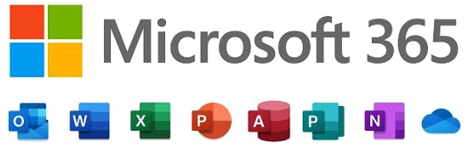
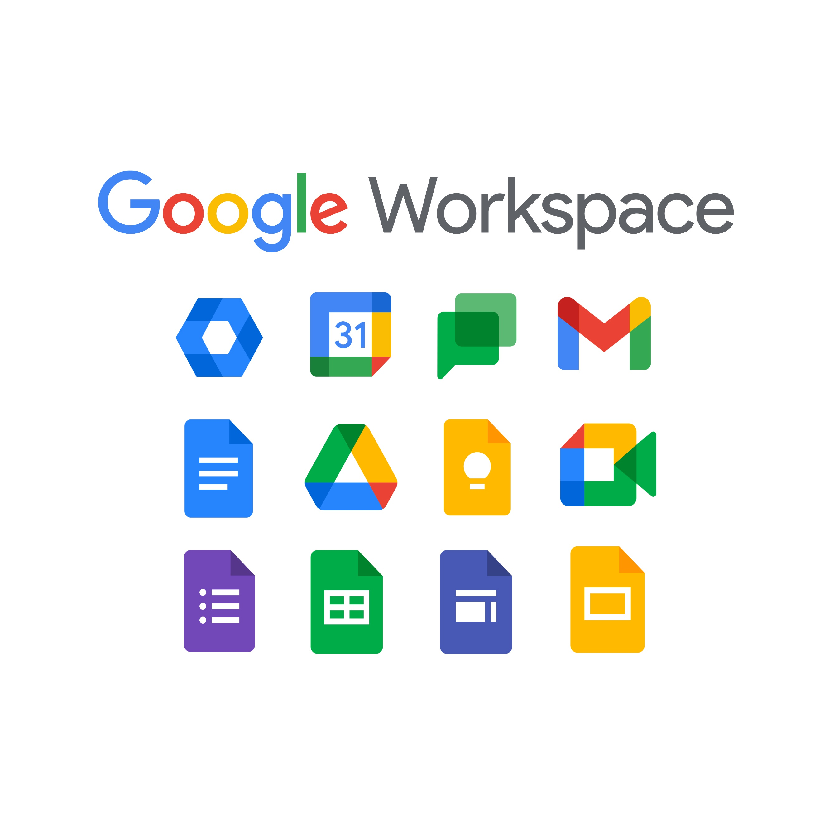
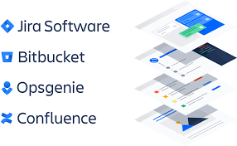
Software as a Service (SaaS)
Examples:
Microsoft 365,
Google Workspace,
Dropbox,
Slack,
Notion,
DocuSign,
Trello, JIRA

Slide 23
Platform as a Service (PaaS)
Consumers:
Developers,
Testers,
Administrators,
End users.
Consumer pays for:
Number of users (active/passive),
Type of users (developer/manager),
Used storage,
Used computing power,
Used bandwidth,
Time of usage.

Slide 24
Platform as a Service (PaaS)
Advantages:
Faster time to market,
One environment from start to finish,
Price,
Ease of licensing.
Disadvantages:
Vendor lock-in,
Vendor dependency,
Security and compliance challenges,
Broadband Dependency.

Slide 25




Platform as a Service (PaaS)
Examples:
AWS Elastic Beanstalk,
Google App Engine,
Red Hat OpenShift,
Azure App Service,
Heroku,
GitHub, GitLab,
Kubernetes,
Docker.

Slide 26
Infrastructure as a Service (IaaS)
Consumers:
Administrators,
Cloud Engineers,
Developers.
Consumer pays for:
Used computing power,
Used storage,
Used bandwidth,
Amount of data downloaded from Cloud,
Services with additional value (monitoring, security, maintanance)

Slide 27
Infrastructure as a Service (IaaS)
Advantages:
Scalability,
Fewer resources dedicated to server maintenance,
Faster time to market.
Disadvantages:
Unexpected Costs,
Process Changes,
Security Risks,
Vendor Lock-In,
Broadband Dependency,
Limited Customization,
Lack of Support.

Slide 28
Infrastructure as a Service (IaaS)
Examples:
Amazon Web Services,
Microsoft Azure,
Google Cloud,
IBM Cloud,
Digital Ocean,
Alibaba Cloud,
Openstack,
KVM,
Ceph.

Slide 29
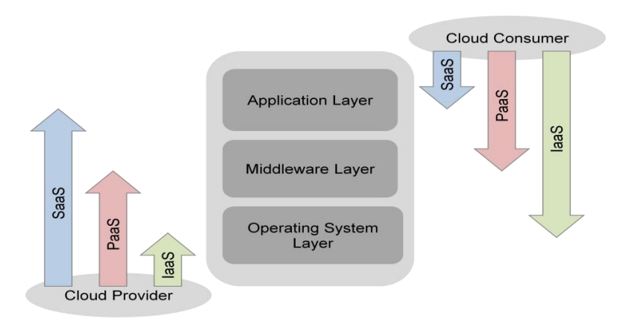
Shared Responsibility Model
The Cloud Provider and Cloud Consumer share the control of resources in a cloud system.

Slide 30
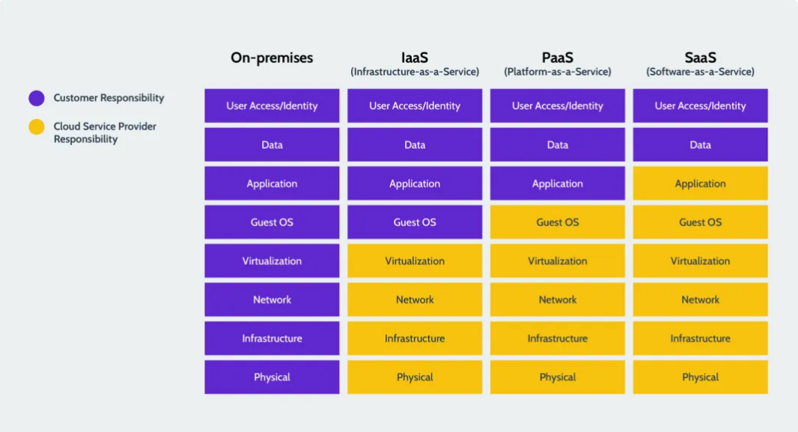
Shared Responsibility Model

Slide 31
Even more ,,aaS’’ …

Slide 32
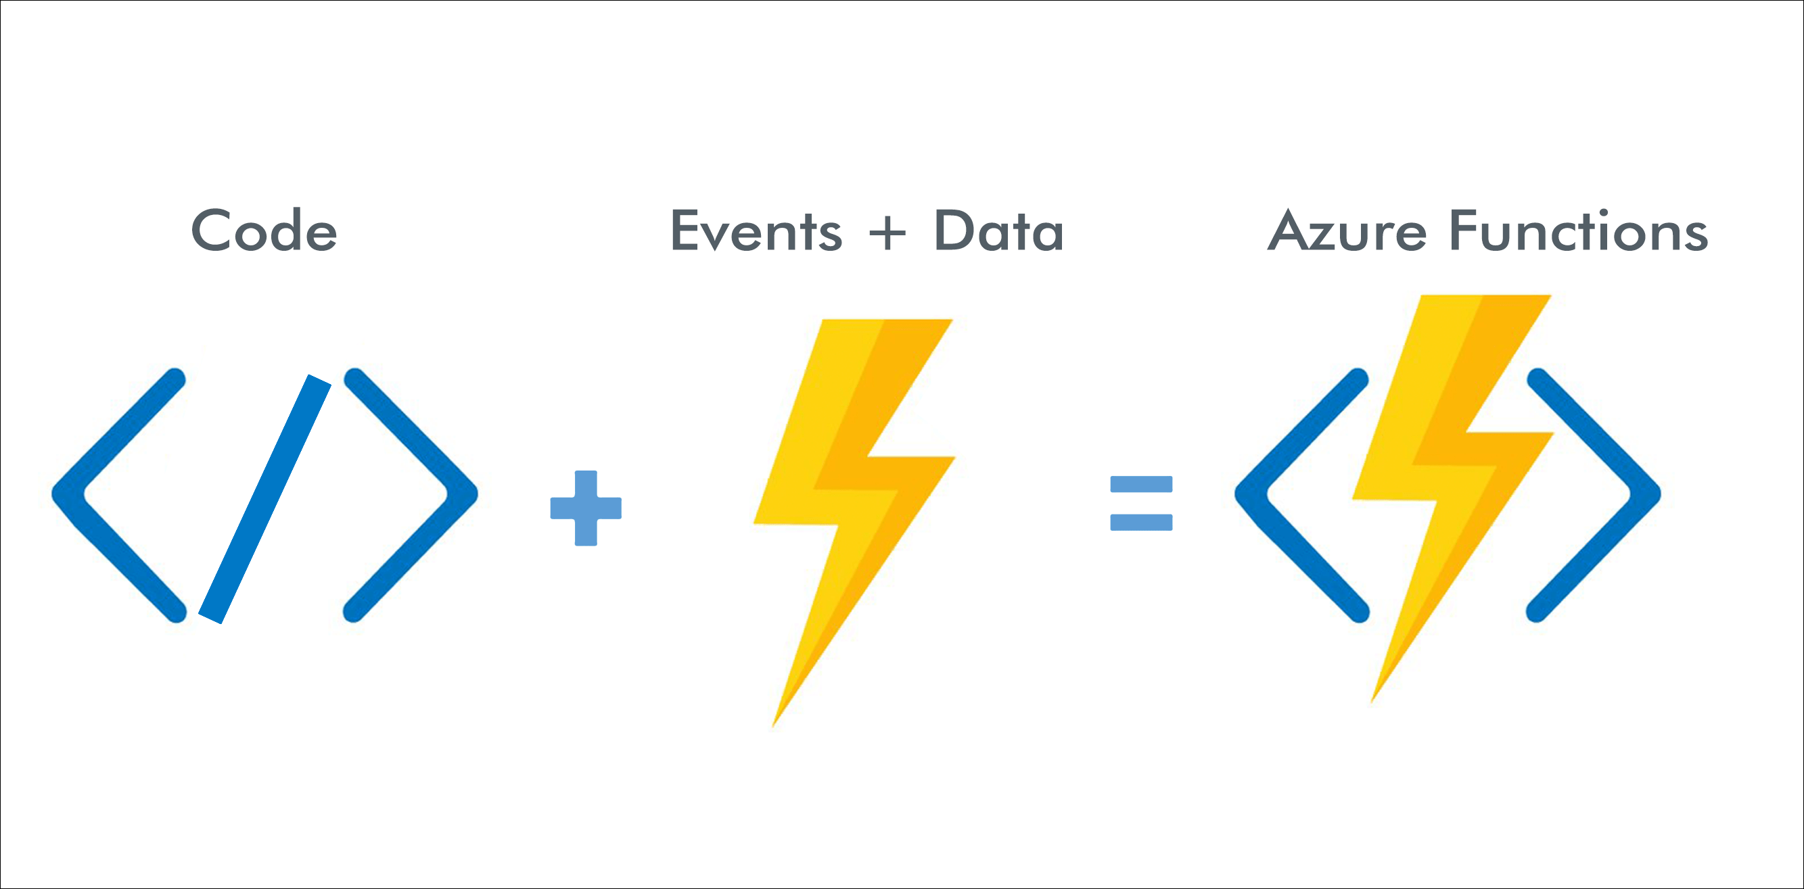
Function as a Service (FaaS)
FaaS is a serverless way to execute modular pieces of code on the edge. FaaS lets developers write and update a piece of code on the fly, which can then be executed in response to an event, such as a user clicking on an element in a web application. This makes it easy to scale code and is a cost-efficient way to implement microservices.

Slide 33
Function as a Service (FaaS)
Advantages:
Cost,
Easy scalability,
Simplified Code,
Decreased latency,
Faster time to market.
Disadvantages:
Vendor lock-in,
Cold starts,
Testing,
Security,
Cost.

Slide 34
Function as a Service (FaaS)
Examples:
Amazon Lambda,
Google Cloud Functions,
Microsoft Azure Functions,
Azure functions
IBM Cloud Functions.

Slide 35
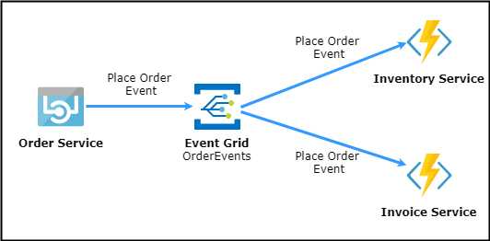
Function as a Service (FaaS) - example

Slide 36
FaaS vs. PaaS, containers and VMs
Provisioning time: Milliseconds, compared to minutes and hours for the other models,
Ongoing administration: None, compared to a sliding scale from easy to hard for PaaS, containers, and VMs respectively,
Elastic scaling: Each action is always instantly and inherently scaled, compared to the other models which offer automatic—but slow—scaling that requires careful tuning of auto-scaling rules,
Capacity planning: None required, compared to the other models requiring a mix of some automatic scaling and some capacity planning.

Slide 37
FaaS vs. PaaS, containers and VMs
Persistent connections and state: Limited ability to persist connections and state must be kept in external service/resource. The other models can leverage http, keep an open socket or connection for long periods of time, and can store state in memory between calls,
Maintenance: All maintenance is managed by the FaaS provider. This is also true for PaaS; containers and VMs require significant maintenance that includes updating/managing operating systems, container images, connections, etc,
High availability (HA) and disaster recovery (DR): HA is inherent in the FaaS model with no extra effort or cost. The other models require additional cost and management effort. In the case of both VMs and containers, infrastructure can be restarted automatically.

Slide 38
FaaS vs. PaaS, containers and VMs
Resource utilization: Resources are never idle - they are invoked only upon request. All other models feature at least some degree of idle capacity,
Resource limits: FaaS is the only model that has resource limits on code size, concurrent activations, memory, run length, etc.,
Charging granularity and billing: Per blocks of 100 milliseconds, compared to by the hour (and sometimes minute) of other models.

Slide 39
Anything (X) as a Service (XaaS)
XaaS reflects how organizations across the globe are adopting the as-a-Service method for delivering just about, well, everything,
XaaS could be simply thought of as a combination of SaaS, PaaS, and IaaS offerings,
The primary goal of XaaS offerings is to increase the value for the customer.
Servitization - the combination of products and services into a single package.

Slide 40
Anything (X) as a Service (XaaS)
Examples:
Hardware as a Service (HaaS),
Communication as a Service (CaaS),
Desktop as a Service (DaaS),
Healhcare as a Service (HaaS)

Slide 41
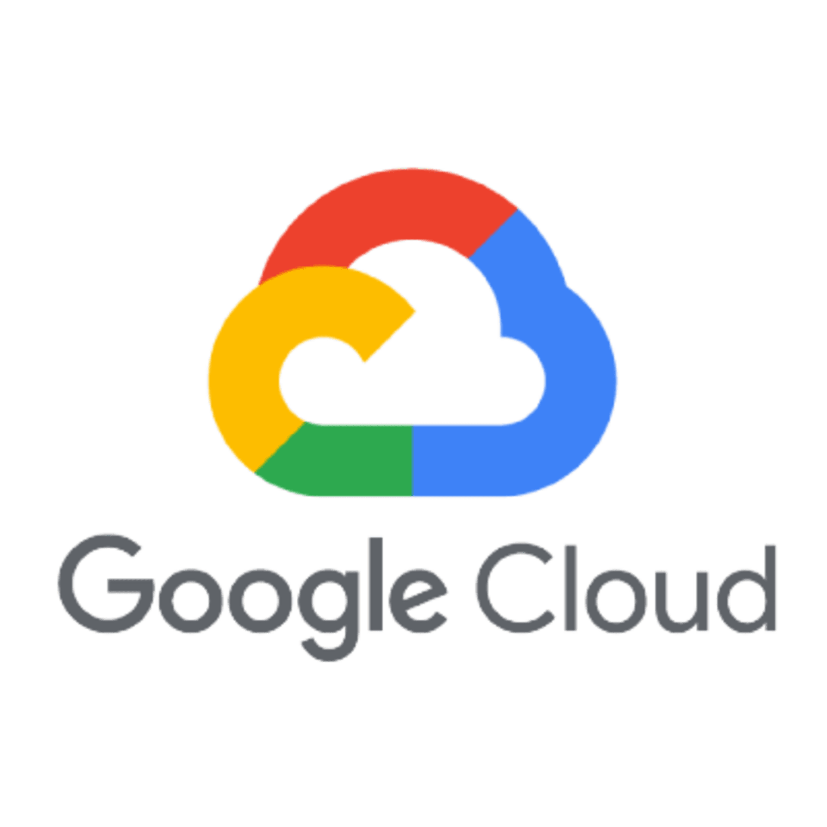


Excercise
For the company, it is necessary to buy a server on which the economic system will run. The system needs to be backed up. System requirements: 64 GB RAM, 200 GB SSD, Windows Server OS. Calculate the total cost for 3 years.

Slide 42
Statistics

Slide 43
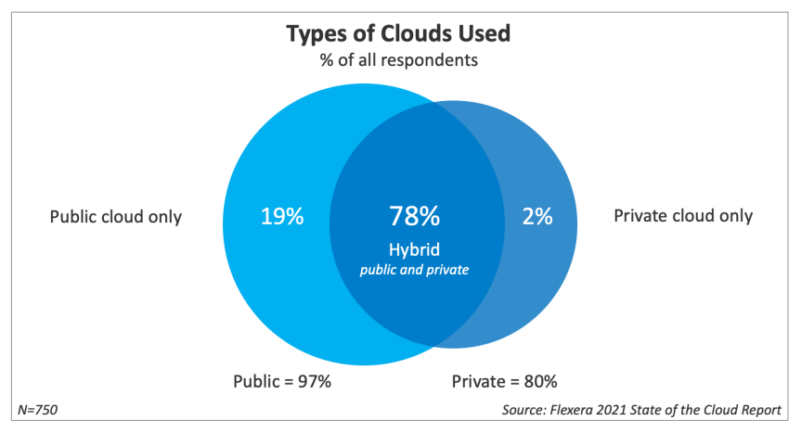
Statistics (Flexera)
Flexera

Slide 44
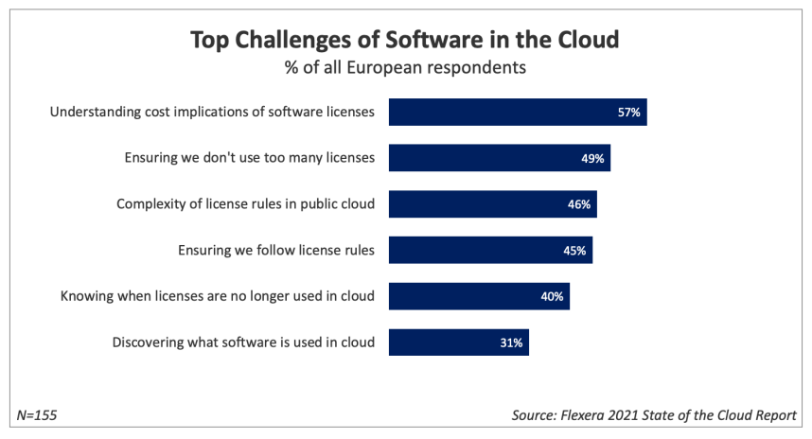
Statistics (Flexera)
Flexera

Slide 45
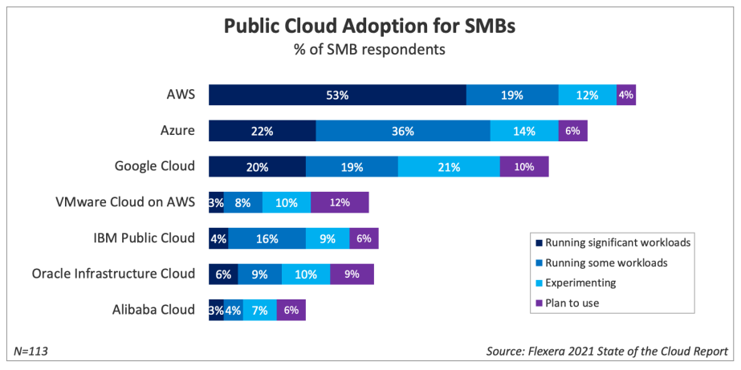
Statistics (Flexera)
Flexera

Slide 46
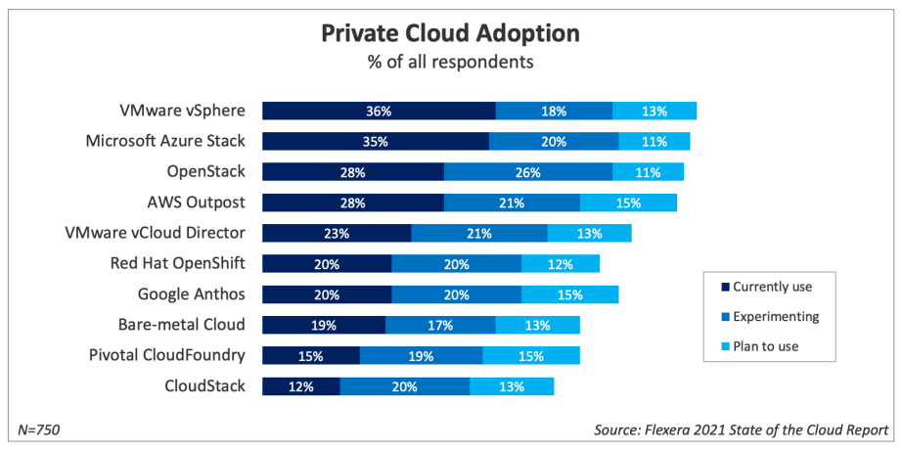
Statistics (Flexera)
Flexera

Slide 47
Thank you!

